Slide 1

Faisal Alabdulkareem
Information systems
Hussam Alshehri
Actuarial Sciences

Slide 2
Faisal Alabdulkareem
Information systems
Hussam Alshehri
Actuarial Sciences

Slide 3
Project
Financial Risk Modeling

Slide 4

Financial Risk Modeling?
Financial risk modeling is the use of formal mathematical and econometric techniques to measure, monitor and control the Financial risk.

Slide 5
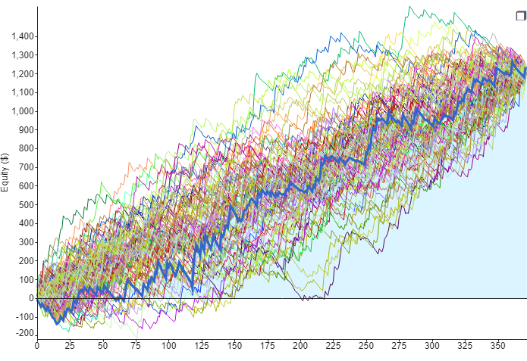

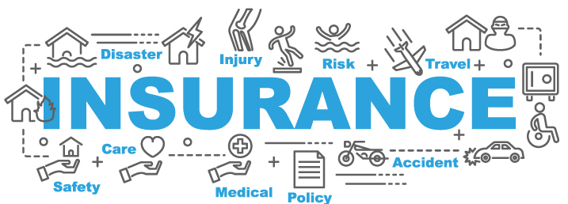
Banking
Insurance
Investment
Fields of practice
How prices are determined?

Slide 6

Banking
Investment
Fields of practice
Car Insurance
How prices are determined?

Slide 7
Fields of practice
Investment
Banking
Insurance

Slide 8
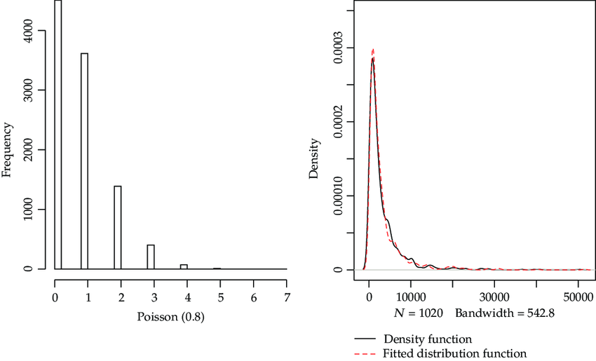
Fields of practice
Insurance
Investment
Banking

Slide 9
How prices are determined?
Insurance
Investment
Price = Cost + profit
Banking

Slide 10

How prices are determined?
Insurance
Investment
Price = Cost + profit
Cost Accounting
Banking

Slide 11
How prices are determined?
Insurance
Investment
Collective risk theory
Software solution
Banking

Slide 12

Price = Cost + profit
Machine Learning
Our Project
Quantum Encryption Methods

Slide 13
Price = Cost + profit
Our Project
Machine Learning
Quantum Encryption Methods

Slide 14

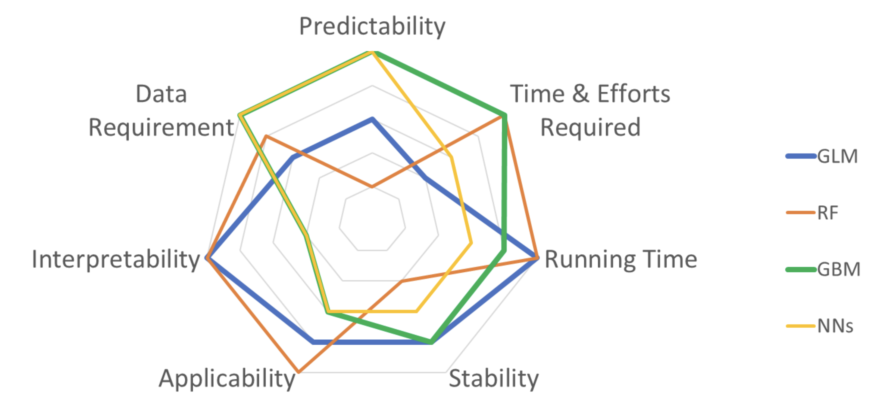
Software solution
Price = Cost + profit
Quantum Encryption Methods
Machine Learning
Insurance Claims Data
Driving.csv
Gradient Boosted Regression Algorithm
Regression Problem
GBR
Notes:
جربنا اكثر من موديل

Slide 15
Insurance Claims Data
Driving.csv
Quantum Encryption Methods
Machine Learning
Gradient Boosted Regression Algorithm
Regression Problem
GBR
Notes:
جربنا اكثر من موديل

Slide 16
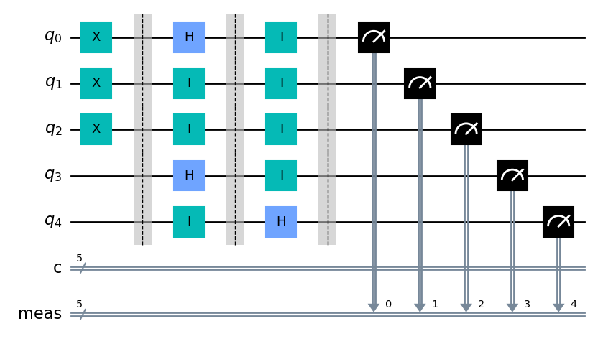

Software solution
Price = Cost + profit
Quantum Encryption Methods
Key Distribution Encryption
Future Security Threats
Machine Learning
Gradient Boosted Regression

Slide 17

Software solution
Price = Cost + profit
Quantum Encryption Methods
Machine Learning
Quantum Key Distribution Encryption (QKD)
Is a secure advanced way to exchange a secret key,
It exploits quantum methods in Quantum Computers
Ahmed
Khaled
Quantum Channel
Symmetric
Symmetric
Notes:
NOTE !!

Slide 18
Software solution
Price = Cost + profit
Quantum Encryption Methods
Machine Learning
Quantum Key Distribution Encryption (QKD)
Is a secure advanced way to exchange a secret key,
It exploits quantum methods in Quantum Computers
Ahmed
Khaled
Quantum Channel
Symmetric
Symmetric
Notes:
NOTE !!

Slide 19
Software solution
Price = Cost + profit
Quantum Encryption Methods
Machine Learning
Quantum Key Distribution Encryption (QKD)
Is a secure way to exchange a secret key,
It exploits quantum effects (methods)
Ahmed
Khaled
Quantum Channel
Symmetric
Symmetric
Notes:
NOTE !!

Slide 20
Machine Learning
TEST

Slide 21
SHIELDED.AI Is aimed for?
Researchers
Risk Analysts
Software Developers

Slide 22
Quantum Key Distribution Encryption
Machine Learning
Conclusion
Notes:
Scale, Future chalange

Slide 23
Machine Learning
Rakan Almutairi
Special Thanks !
Nasser Alnassar
Notes:
Scale, Future chalange

Slide 24



Conclusion
e0e7ec
Machine Learning
Faisal Alabdulkareem
Information systems
Hussam Alshehri
Actuarial Sciences
Spyros Makridakis
Notes:
Scale, Future chalange

Slide 25
Conclusion
e0e7ec
Machine Learning
Faisal Alabdulkareem
Information systems
Hussam Alshehri
Actuarial Sciences
Spyros Makridakis
Notes:
Scale, Future chalange

Slide 28
Conclusion
e0e7ec
Machine Learning
Faisal Alabdulkareem
Information systems
Hussam Alshehri
Actuarial Sciences
Spyros Makridakis
Notes:
Scale, Future chalange

Slide 29
Conclusion
Machine Learning
Faisal Alabdulkareem
Information systems
Hussam Alshehri
Actuarial Sciences
Spyros Makridakis
Notes:
Scale, Future chalange

